Slide 1


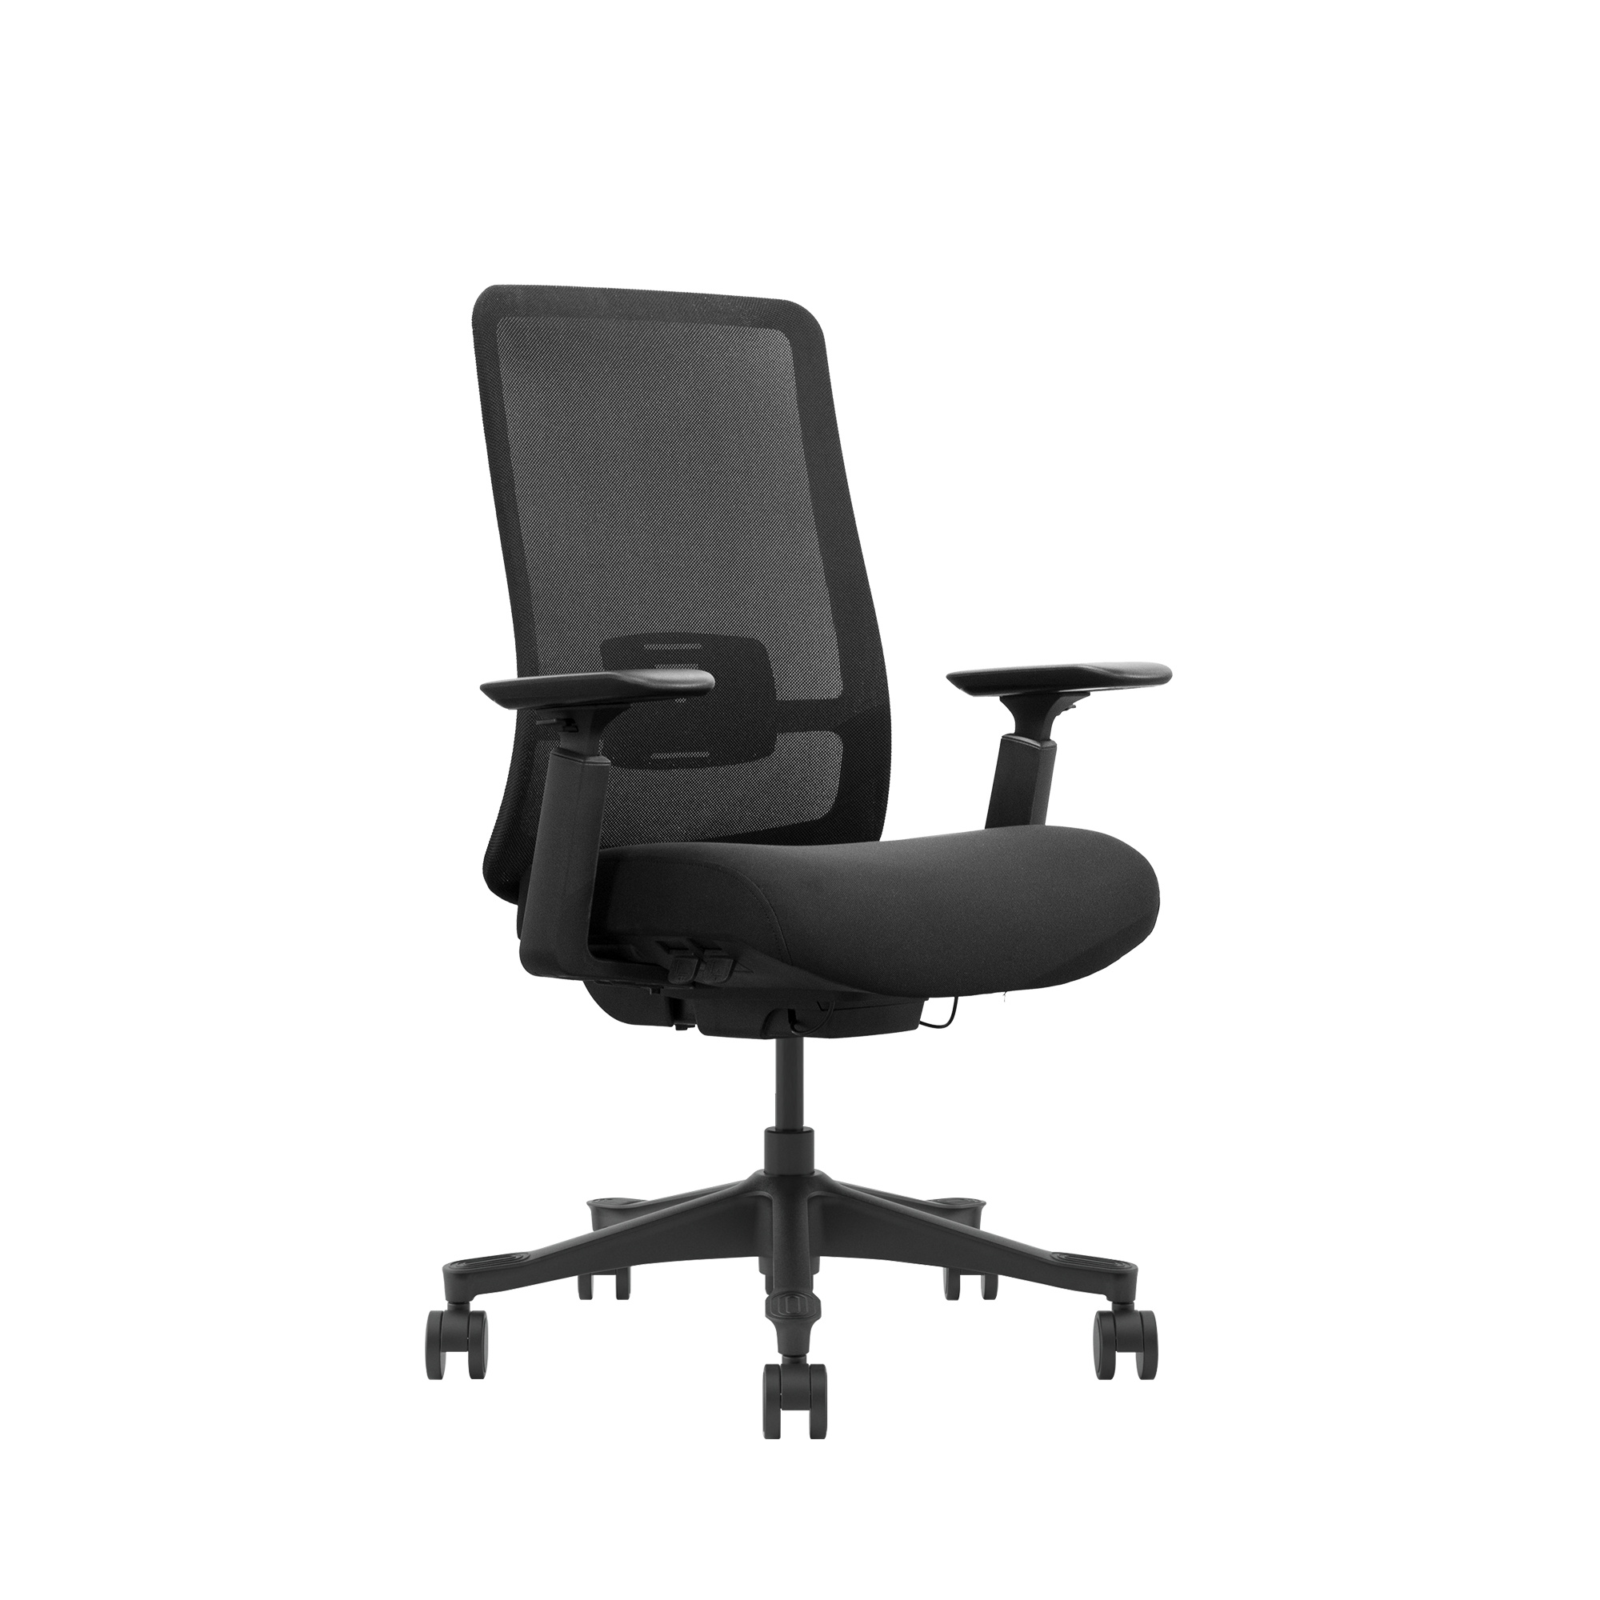
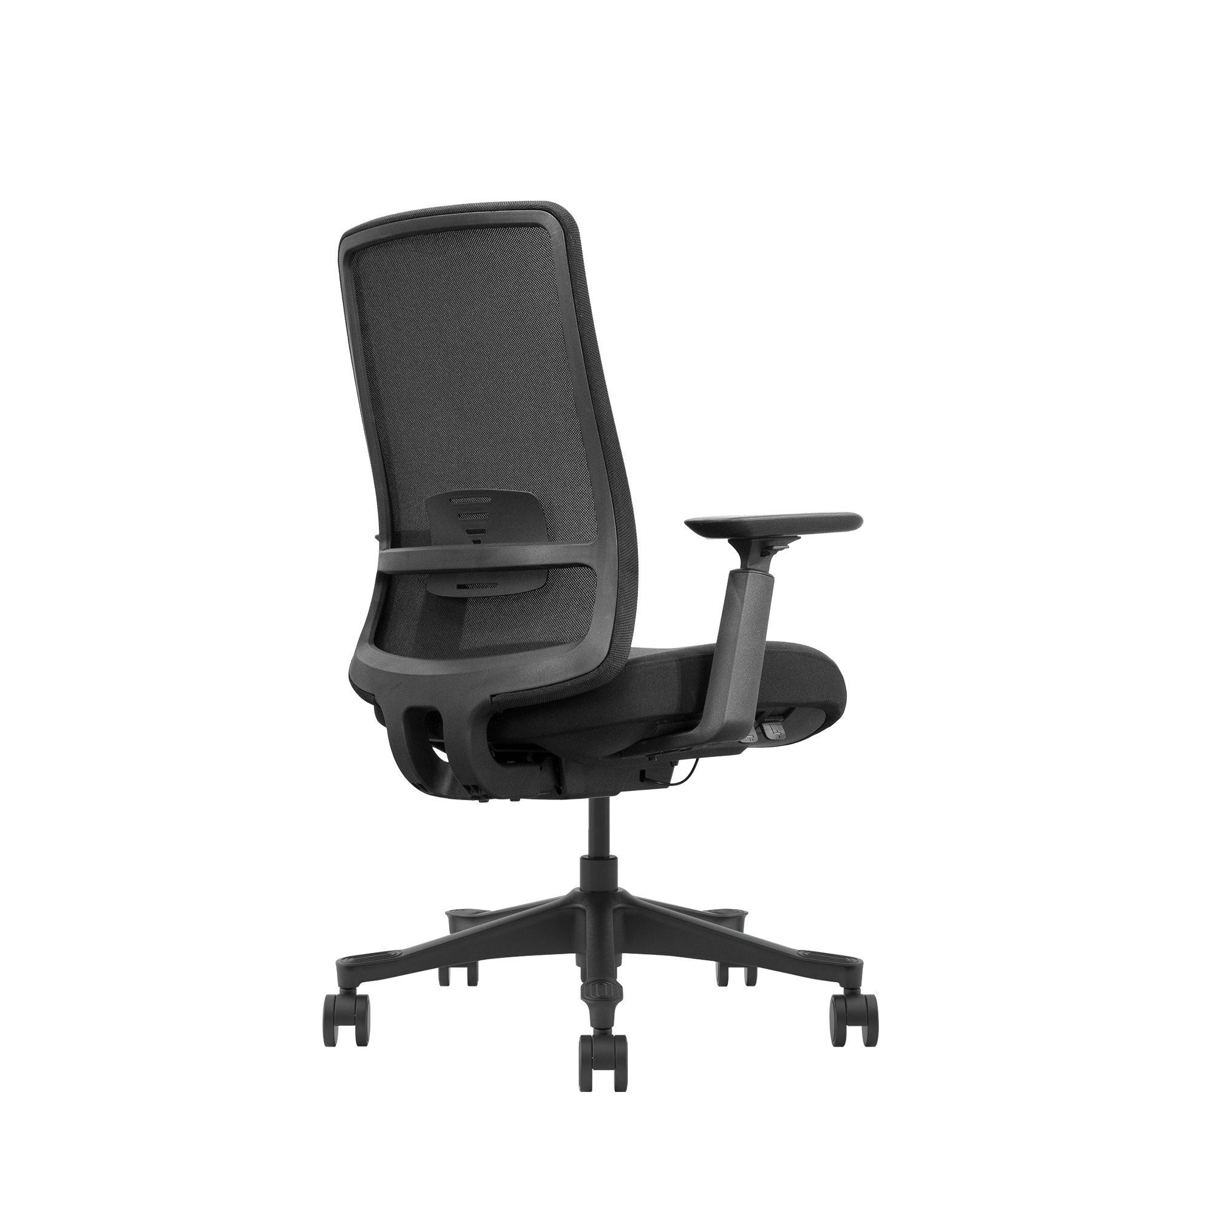
OFFICE CHAIR
BIFMA
International authority certification
NEW
PRODUCT
Concise , comfortable and elegant .fit to the human body , size andshape , design , attention is put to complete relaxation.

Slide 2
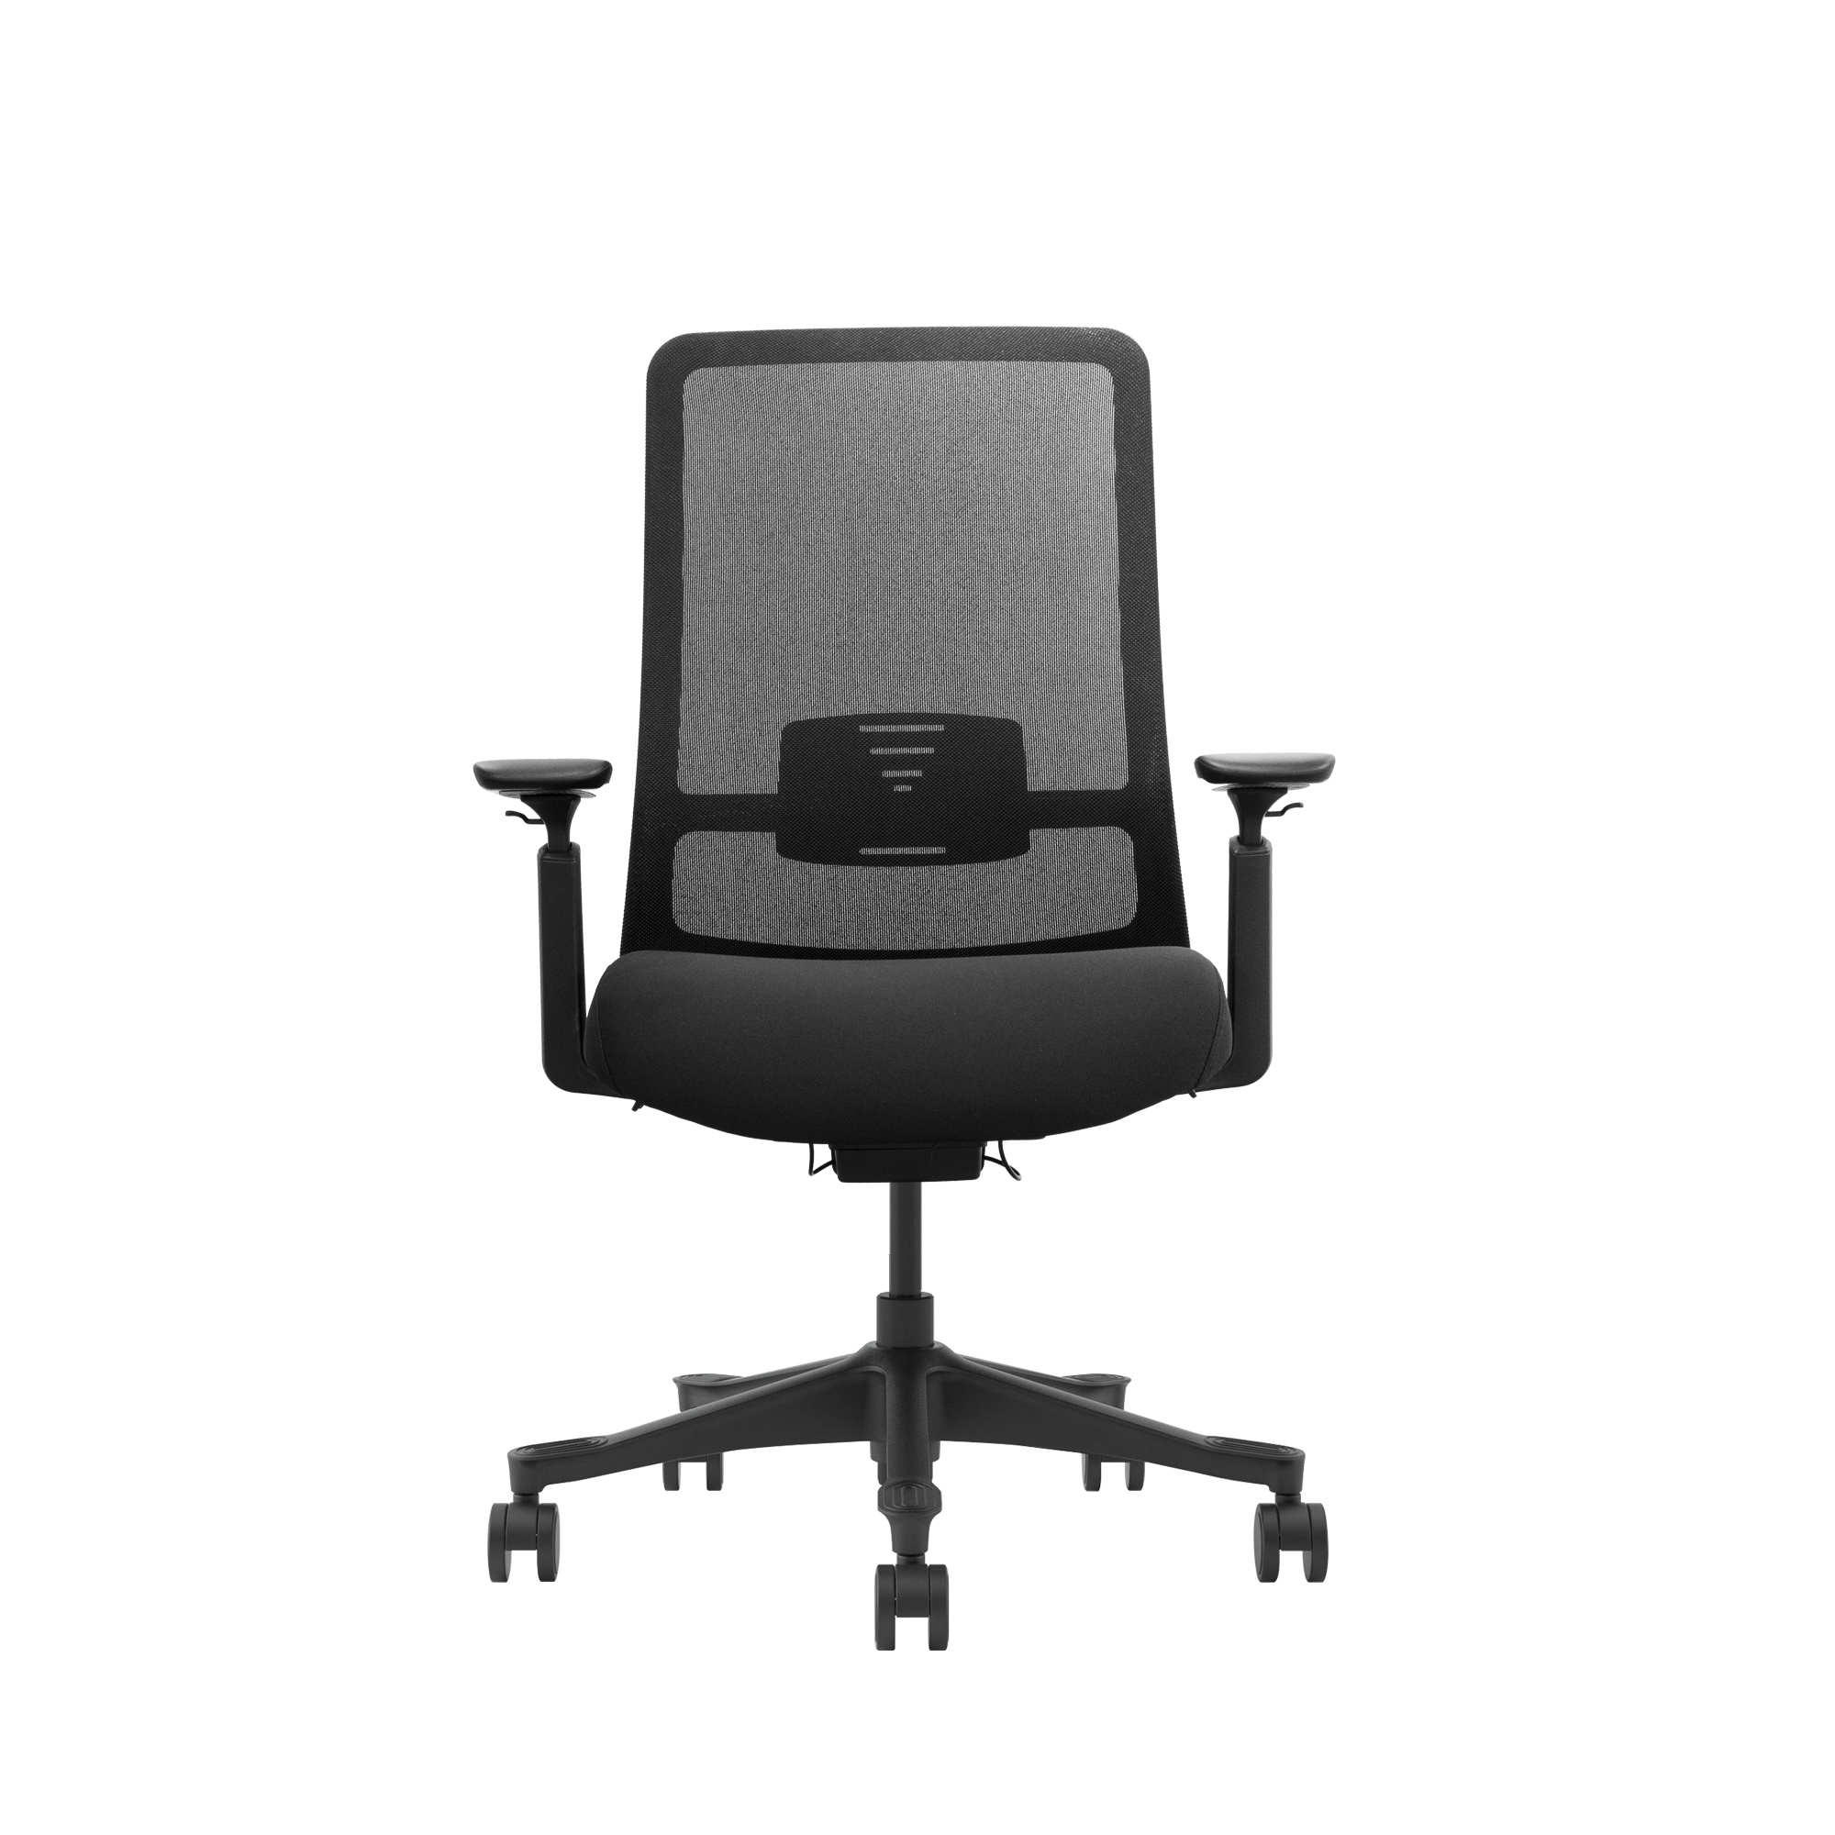
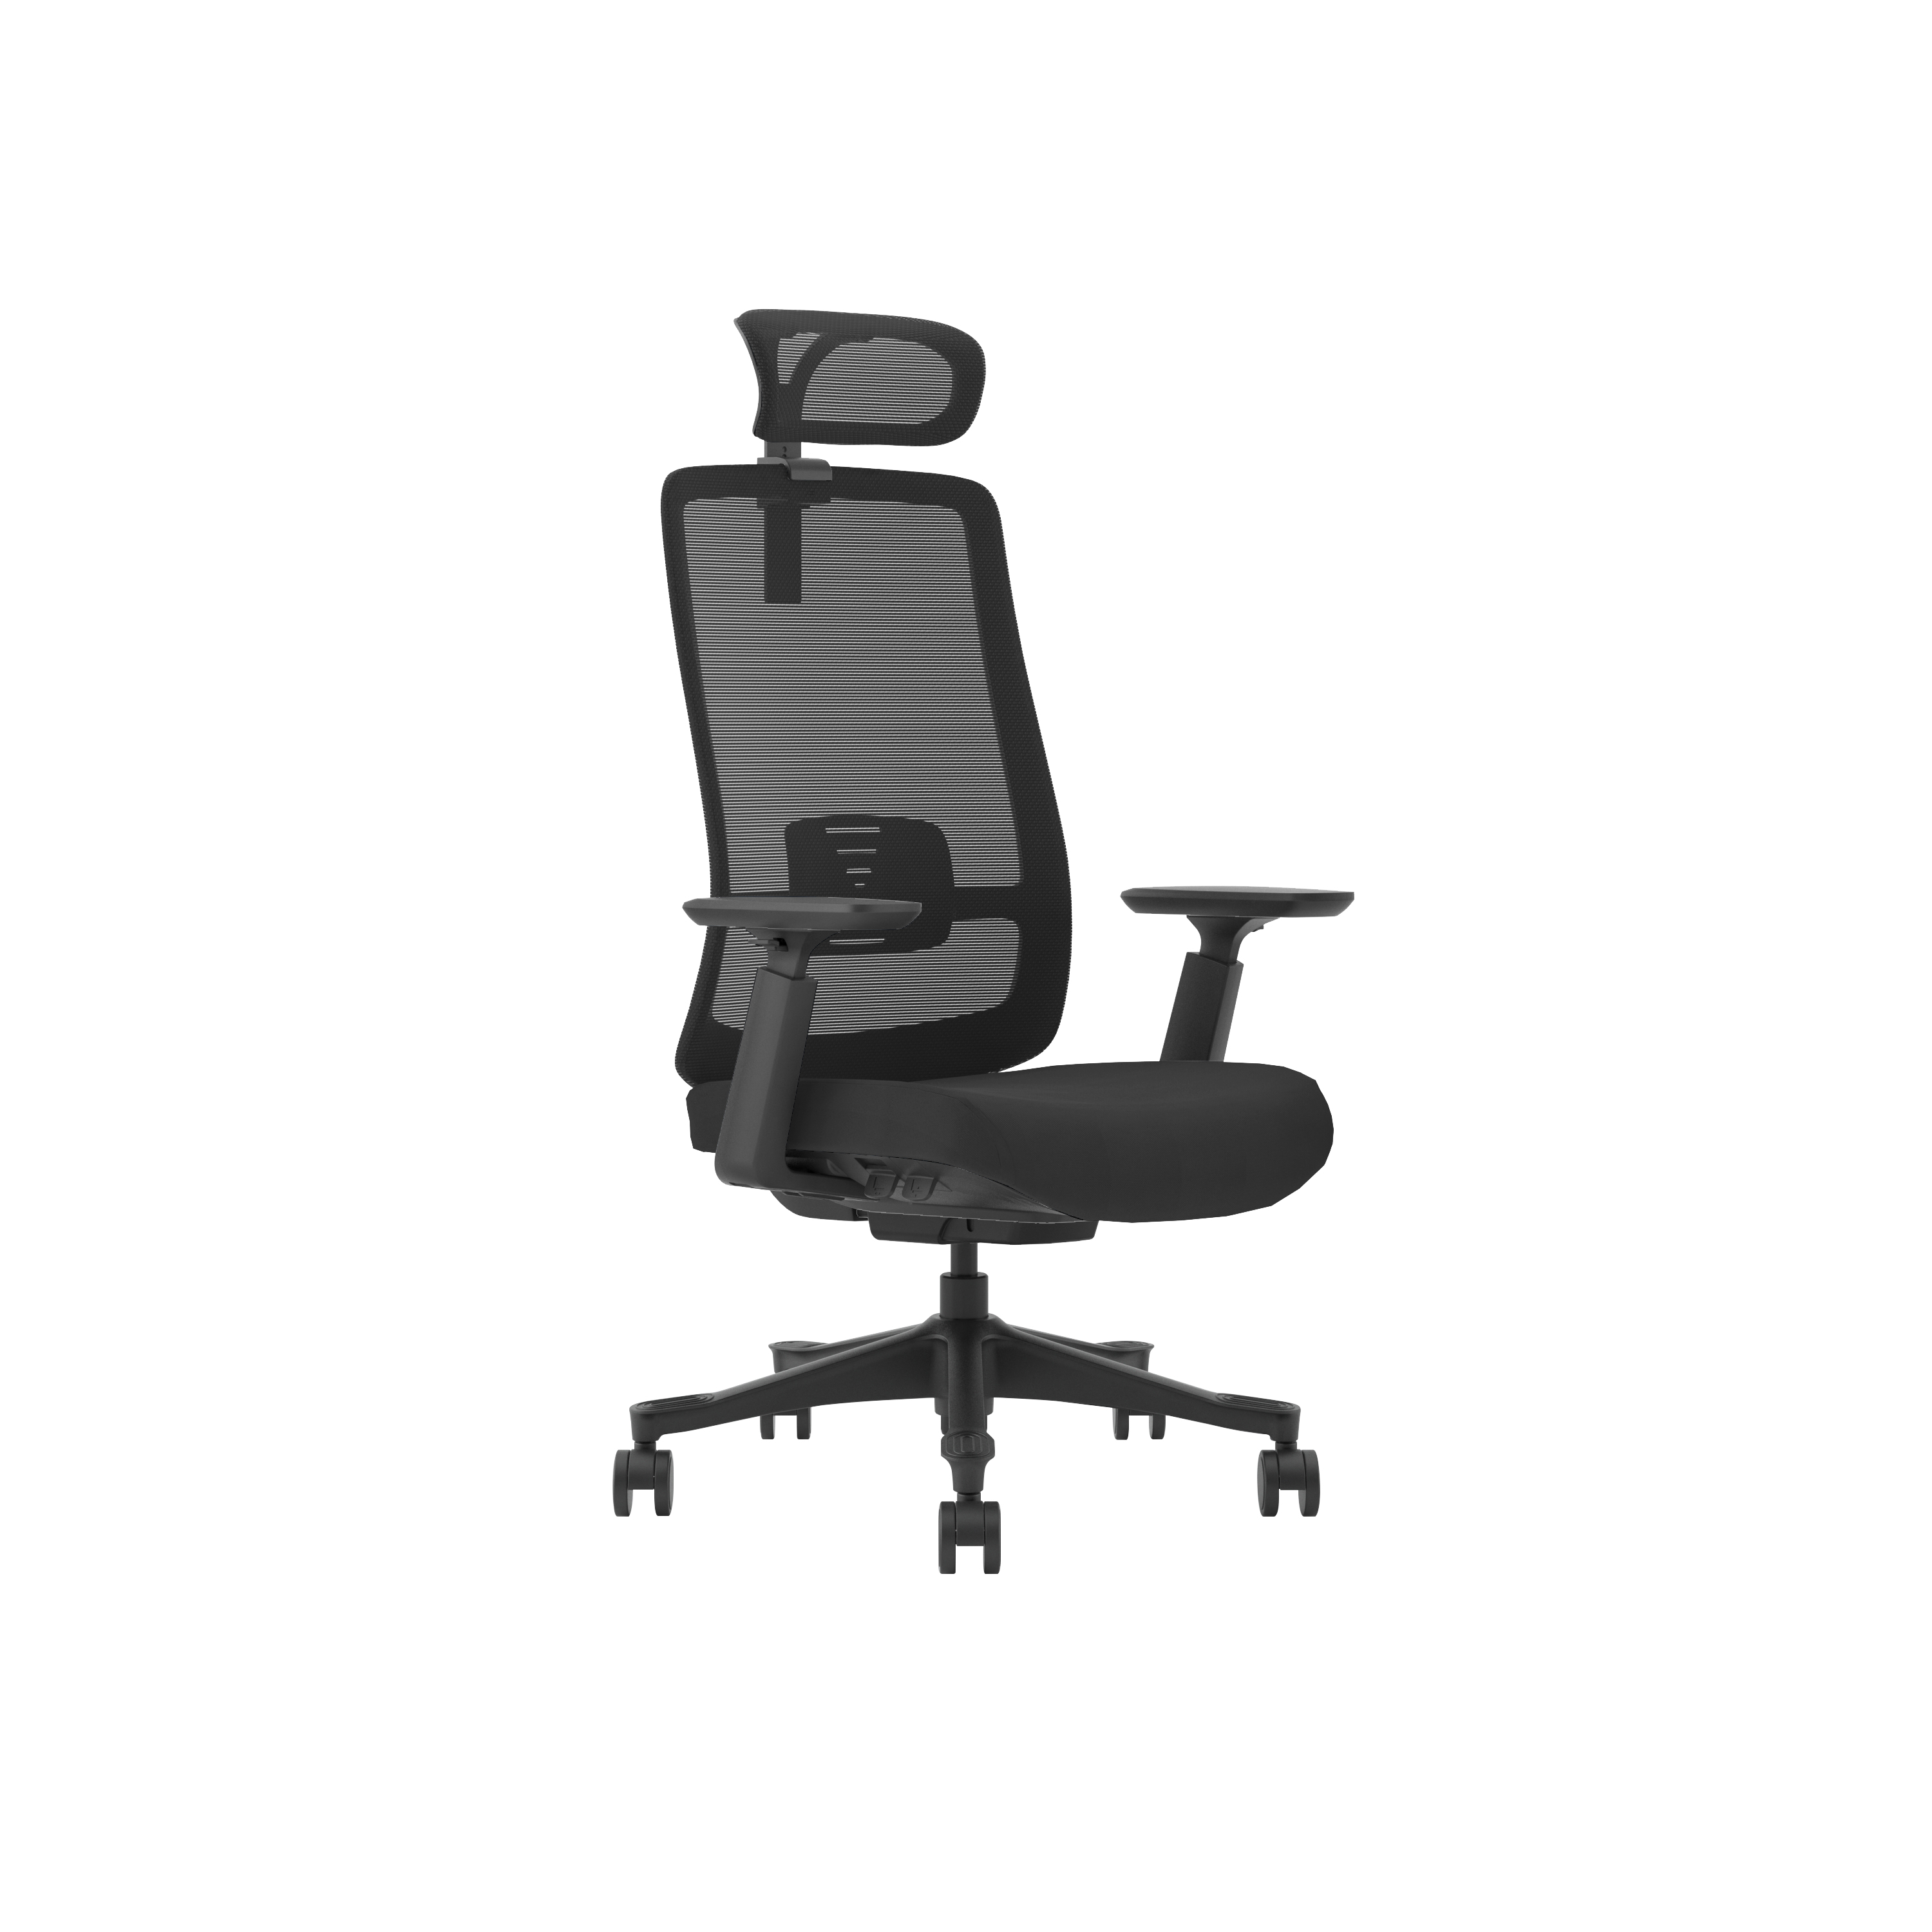
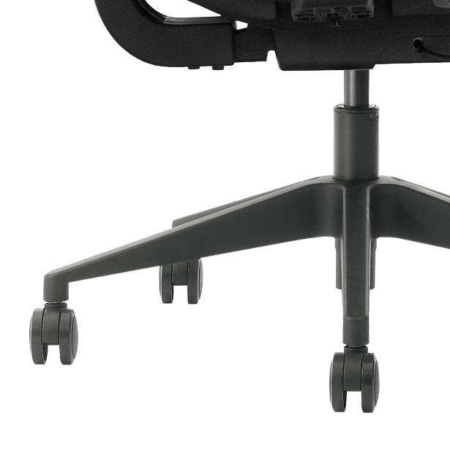
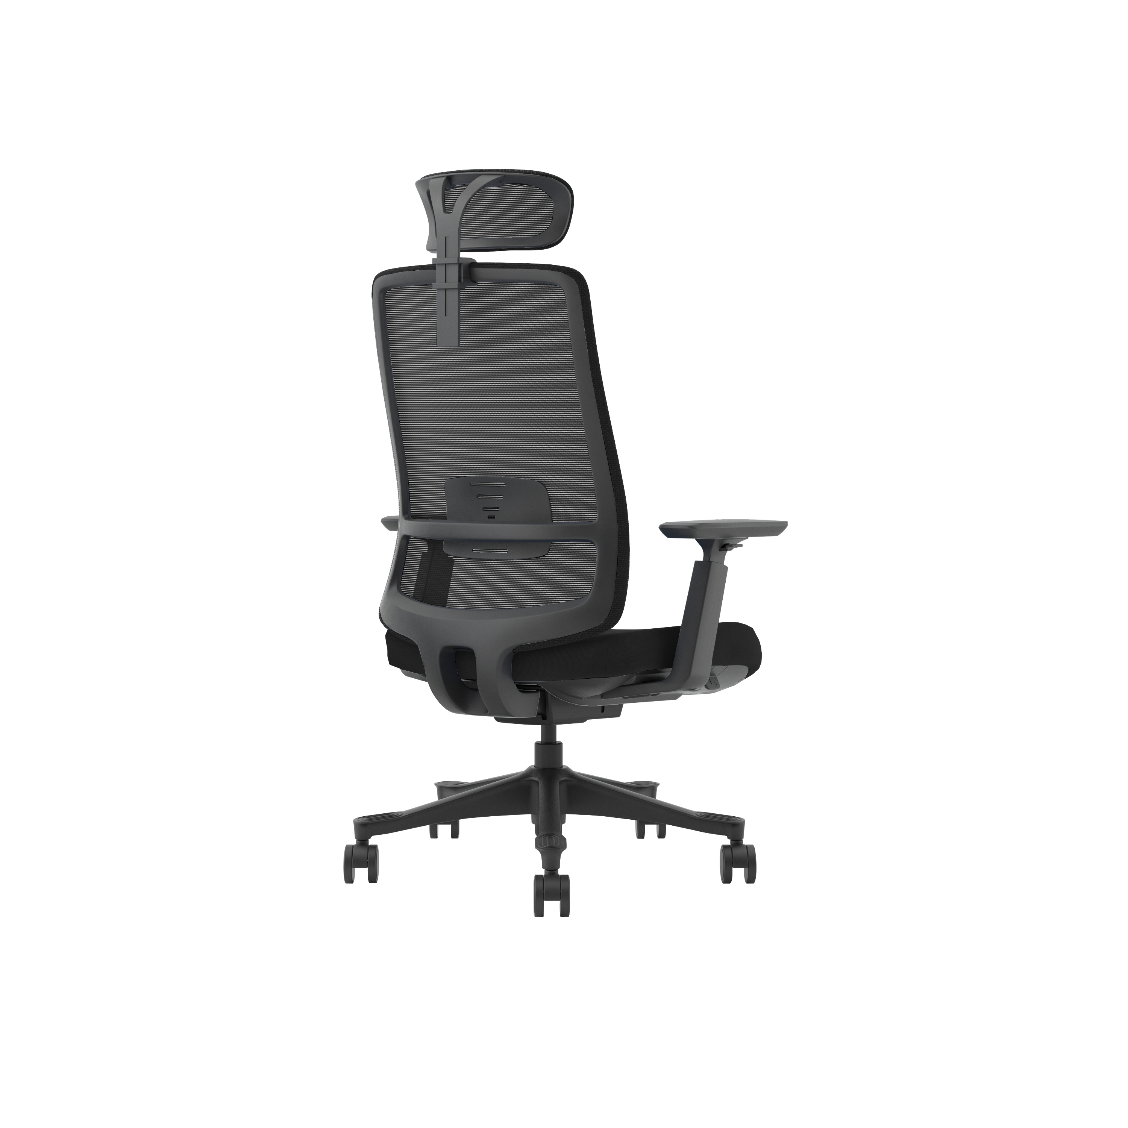
BIFMA Standard Ergonomic Office Chair (Black frame)
*Lumbar support is available in 5 colors (dark fabric matches better with colorful lumbar support
*Backrest: Humanized automatic backrest elastic adjustment, flexibly adapt to the different use states of the human body.
*Seat: Eco-friendly material instead of wood structure. no glue (0 formaldehyde).with mould foam with ergonomic design.
*3D adjustable armrest: front and rear, up and down, rotation adjustment, multi-angle adjustment to meet the needs of more people. Soft PU pad design.
*Mechanism: wire-controlled aluminum mechanism 3-gear locking, seat with sliding function. All buttons are at your fingertips. Easily adjust all functions without bending over.
*Seat height adjustable by grade 4 gas lift (Lifting stroke 100MM.）
*350# black nylon track design base (non-slip on the track), static pressure bearing 1136 kg.
*60# BIFMA 360° running nylon castors
*Back use GT series meshes meet REACH standard and do not contain heavy metals.
*Seat use LY series fabric :grade 5 waterproof, grade 6 oil resistance.

Slide 3
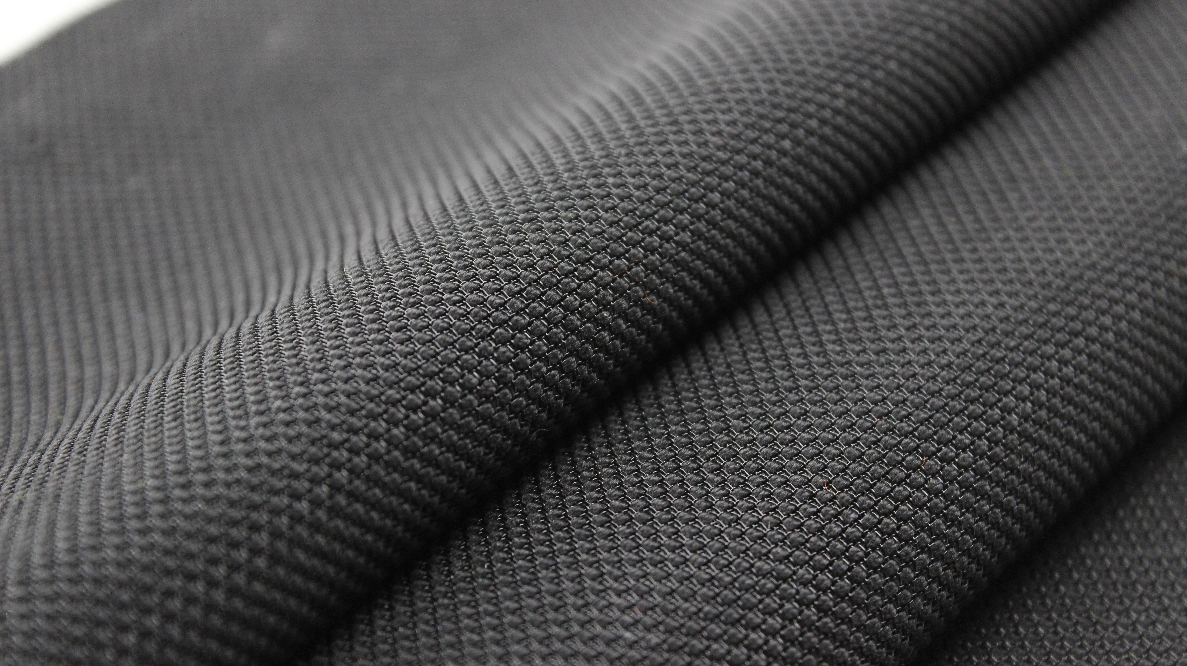






Type
GT-01
GT series of high elastic mesh
Ergonomics, can maintain the mesh pattern without being deformed
SVHC
Formaldehyde content
NOT Detectable
Abrasion Resistance
Endpoint-Lengthwise is >100,000 cycles
Endpoint-Widthwise is >100,000 cycles
Smolder Retardant
RUB Fastness
Dry Staining: 4 grade
Wet staining: 4 grade
Tear Strength
Length is 116N
Transverse avulsion is 176N
According to the specified scope and evaluation screening, the test results of SVHC are <0.1%(w/w)-- PASS
Fire retardant , it pass the fire retadant standard of CA TB117-2013

Slide 4
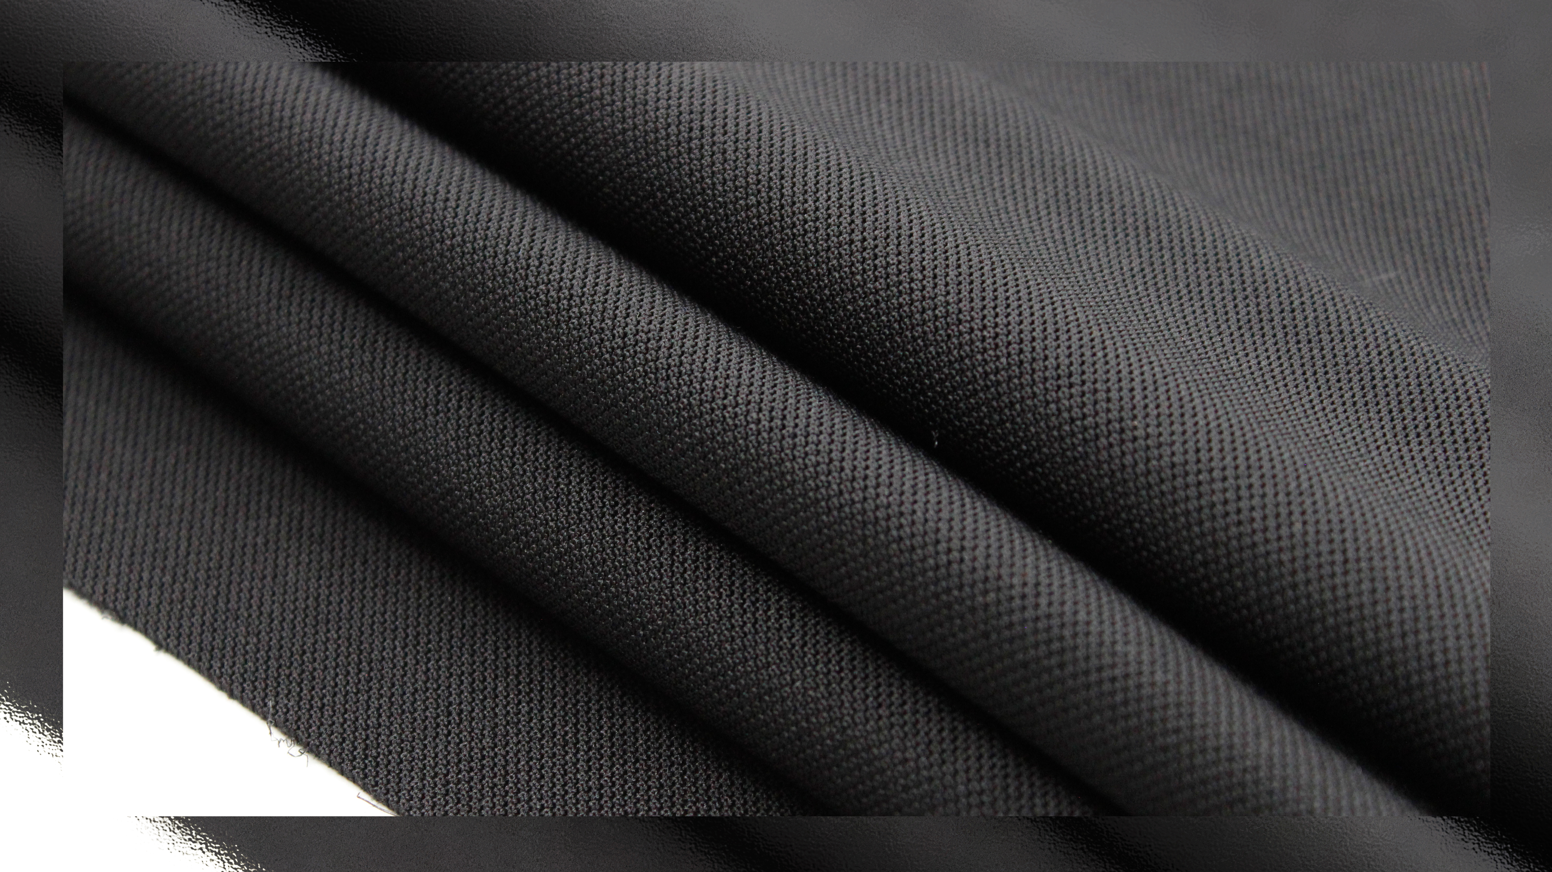


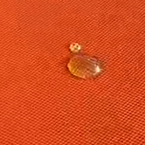

Type
SVHC
LY-01
According to the specified scope and evaluation screening, the test results of SVHC are <0.1%(w/w)-- PASS
Water-proof fabric for seat
Smolder Retardant
Fire retardant , it pass the fire retadant standard of CA TB117-2013
Water Repellency
Grade 6
Oil Repellency Grade
Grade 6
Abrasion Resistance
Endpoint-Lengthwise is >100,000 cycles
Endpoint-Widthwise is >100,000 cycles
RUB Fastness
Dry Staining: Grade 4
Wet staining: Grade 4

Slide 5
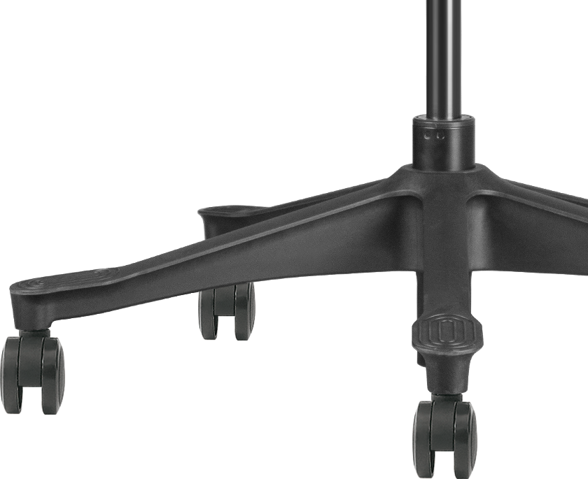
350 nylon basE
in black
BIFMA standard test, high-strength load-bearing
350 mm
1136 kg
Size
Load capacity
*The pictures only show creative ideas, the specific data shall prevail

Slide 6
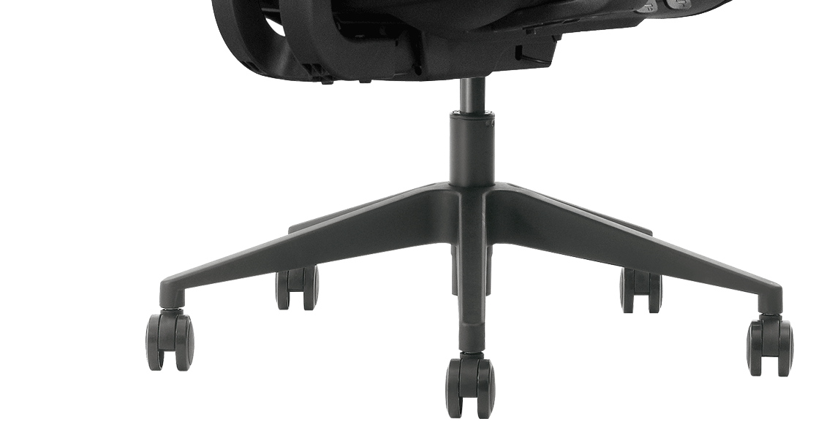
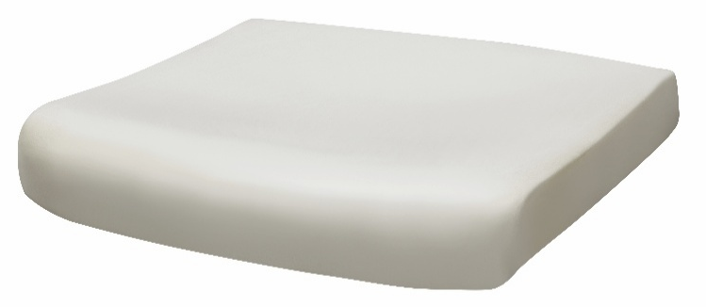
The perfect combination
of art and science

Slide 7
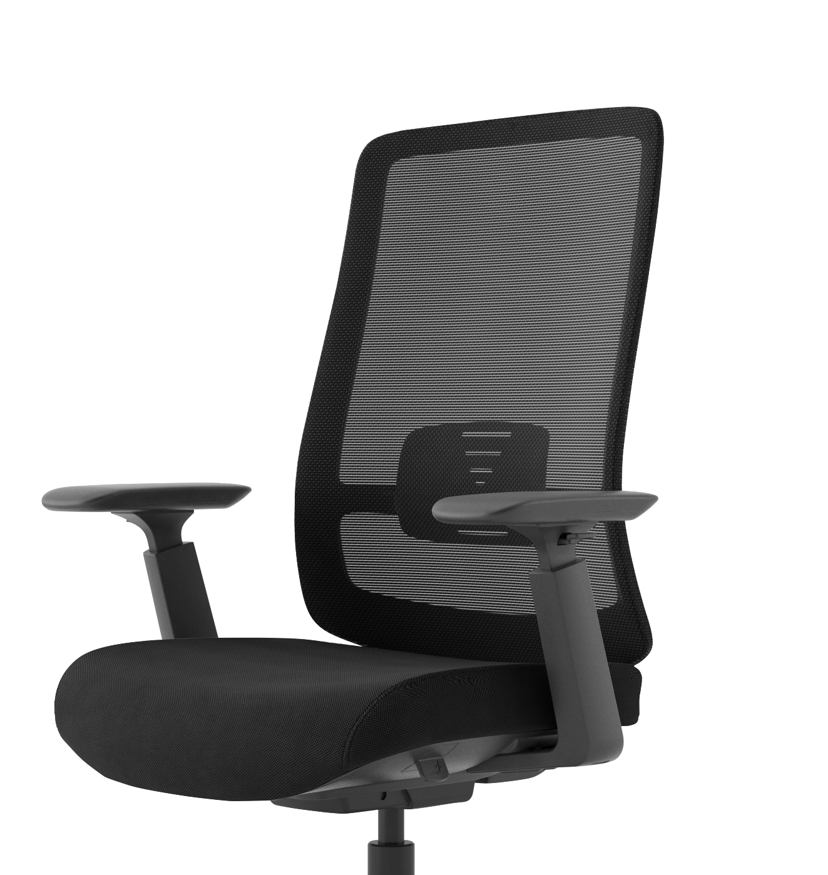
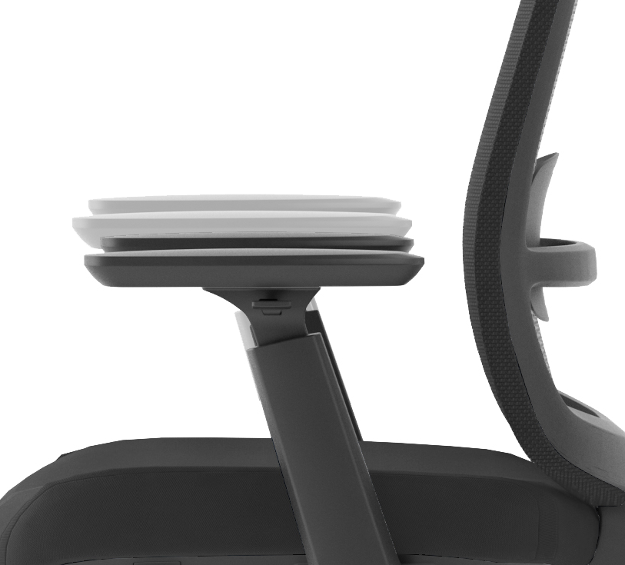
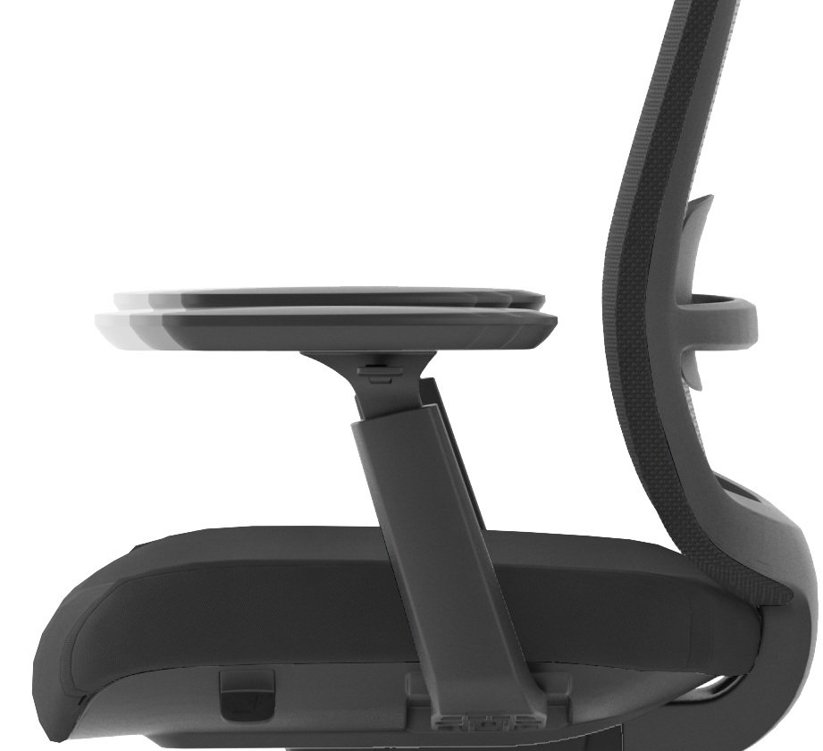
3D Arms
Arms in BLACK
Armrest pad
rotation
Armrest height
adjustment
Armrest pad can slide
back and forth
1.Height adjustable arms, with soft touch PU pad.
2.The arm pad can be rotated, and it can be adjusted forward and backward.
3.No sudden and major change in the structural intergrity when 76 kg applied for 1 min.

Slide 8
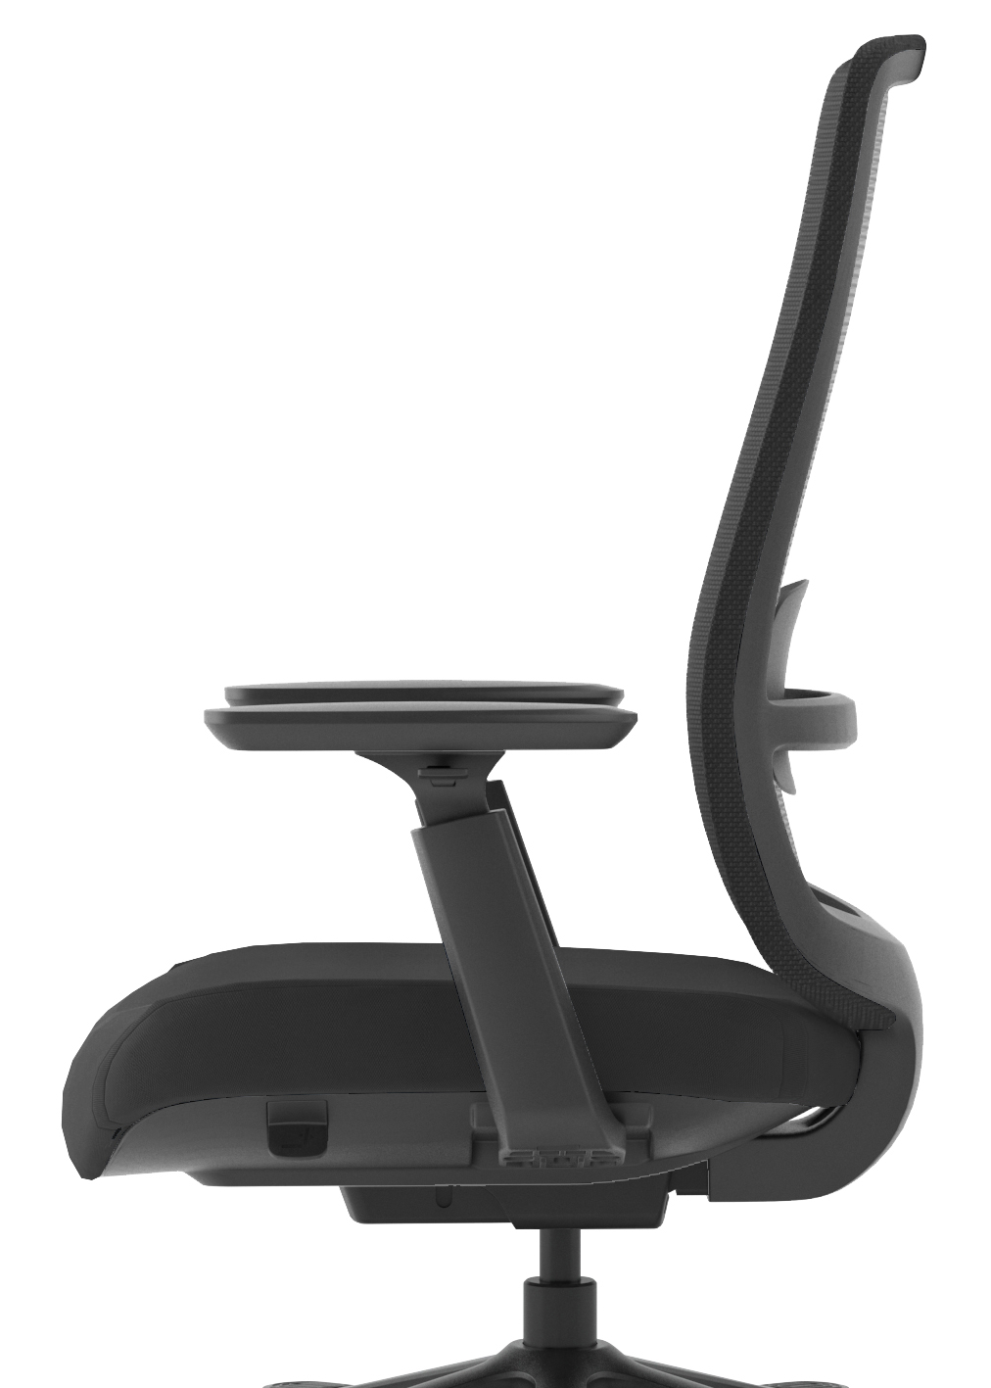
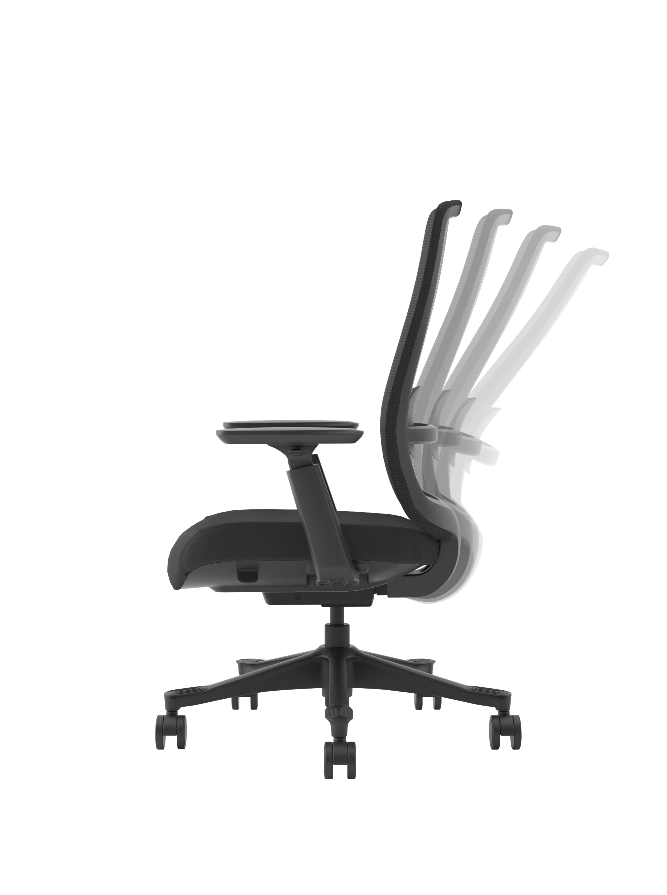
Backrest Tilting degree
90°
120°
It is able to offer good siting feelings to users.
It would reduce stress to abdomen.

Slide 9
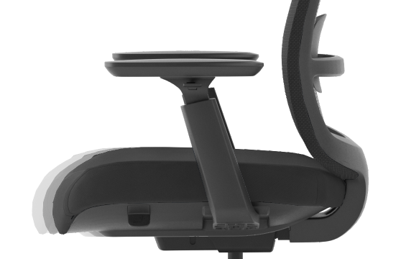
Seat with sliding function
The seat depth can be adjusted according
to the user's habits

Slide 10

Basic configuration（Support customization）

